Slide 1
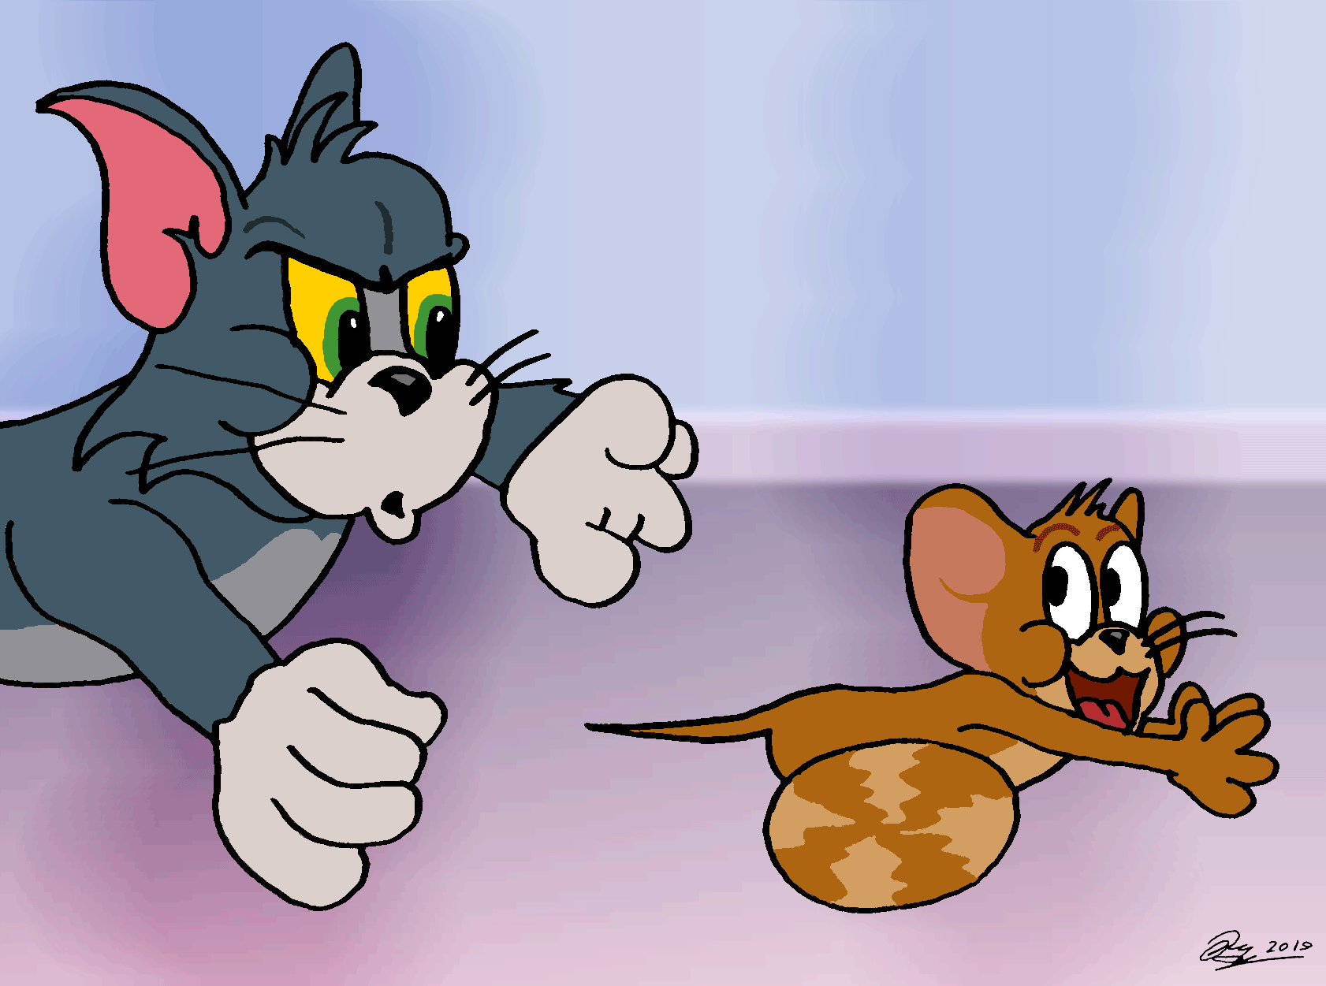
I’m Jerry.
I’m a short and thin rat.
Hi! My name is Tom.
I’m a tall and strong cat.

Slide 2
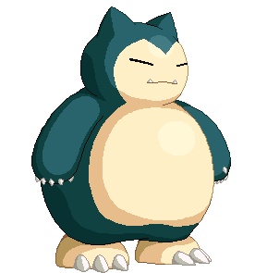
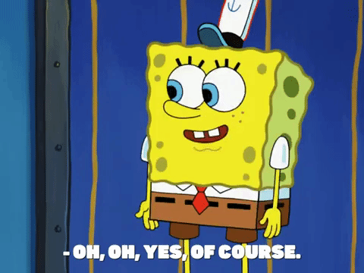
Did you finish your homework?

Slide 3
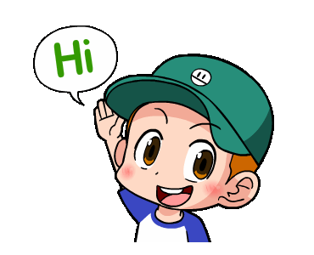
a boy

Slide 4
a girl

Slide 5
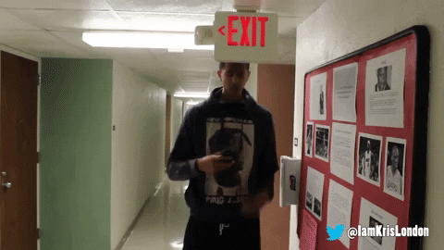
tall

Slide 6
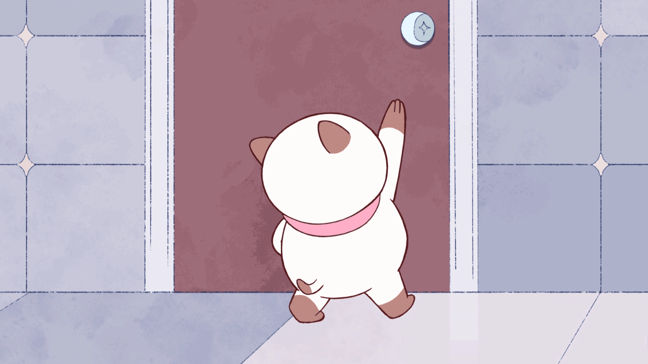
short

Slide 7
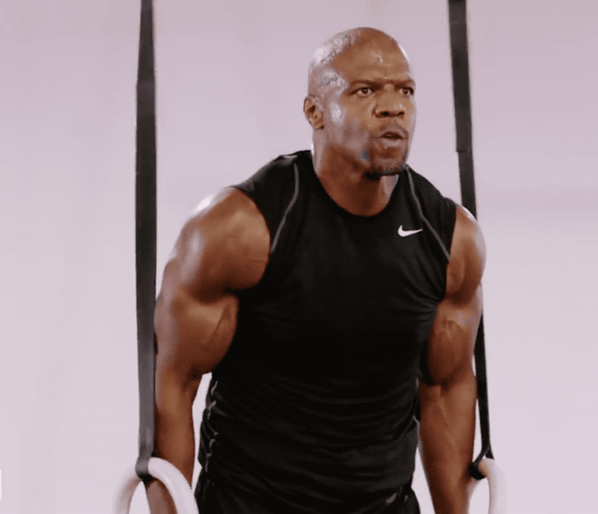
strong

Slide 8
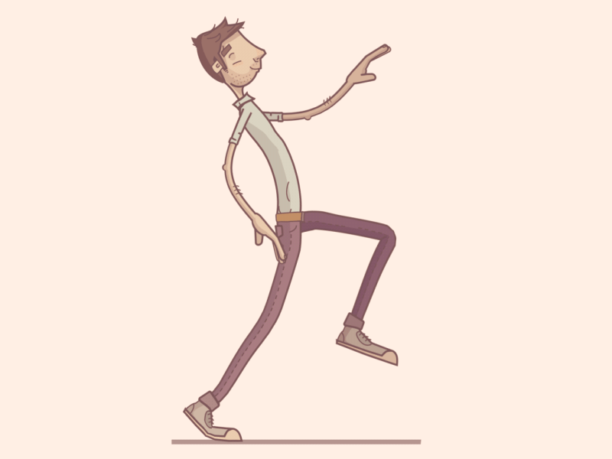
thin

Slide 9
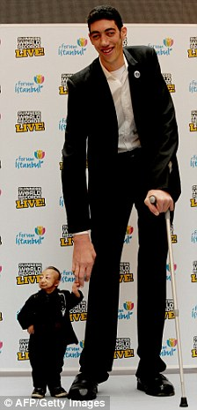
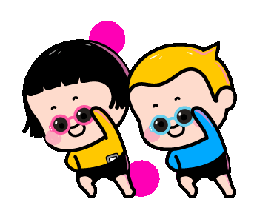
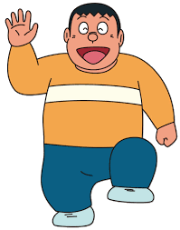
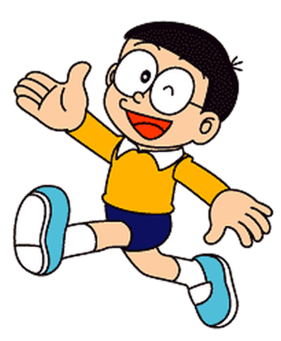
tall
strong
a boy
a girl
thin
short

Slide 11
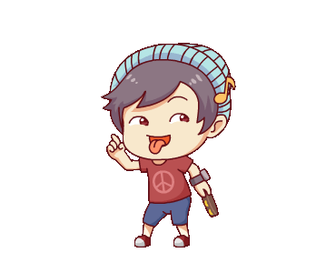
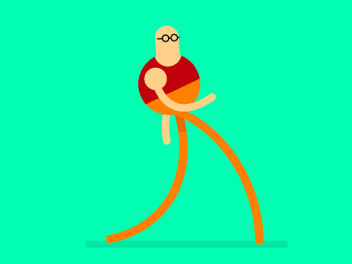
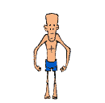
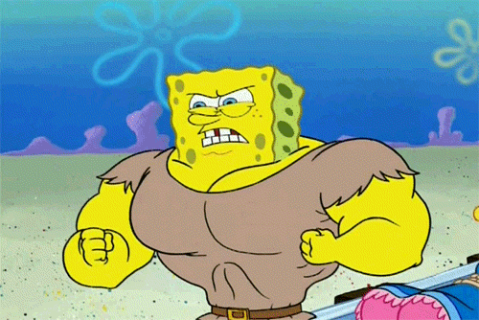
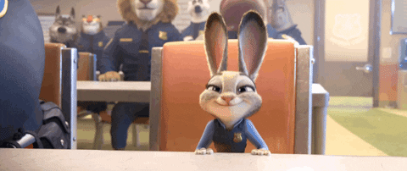
1
2
3
a boy
a girl
tall
4
5
6
short
strong
thin

Slide 12
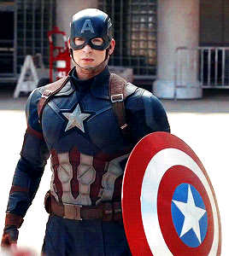
Are you strong?
Yes, I am.
I am strong.

Slide 13
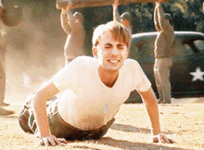
Are you strong?
No, I’m not.
I am thin.

Slide 14
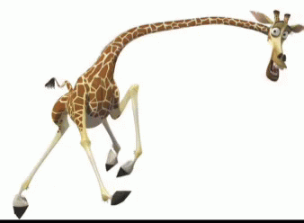
Are you tall?
Yes, I am.
I am tall.

Slide 15
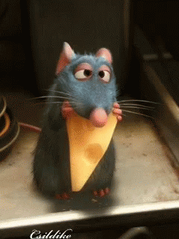
Are you tall?
No, I’m not.
I am short.

Slide 16
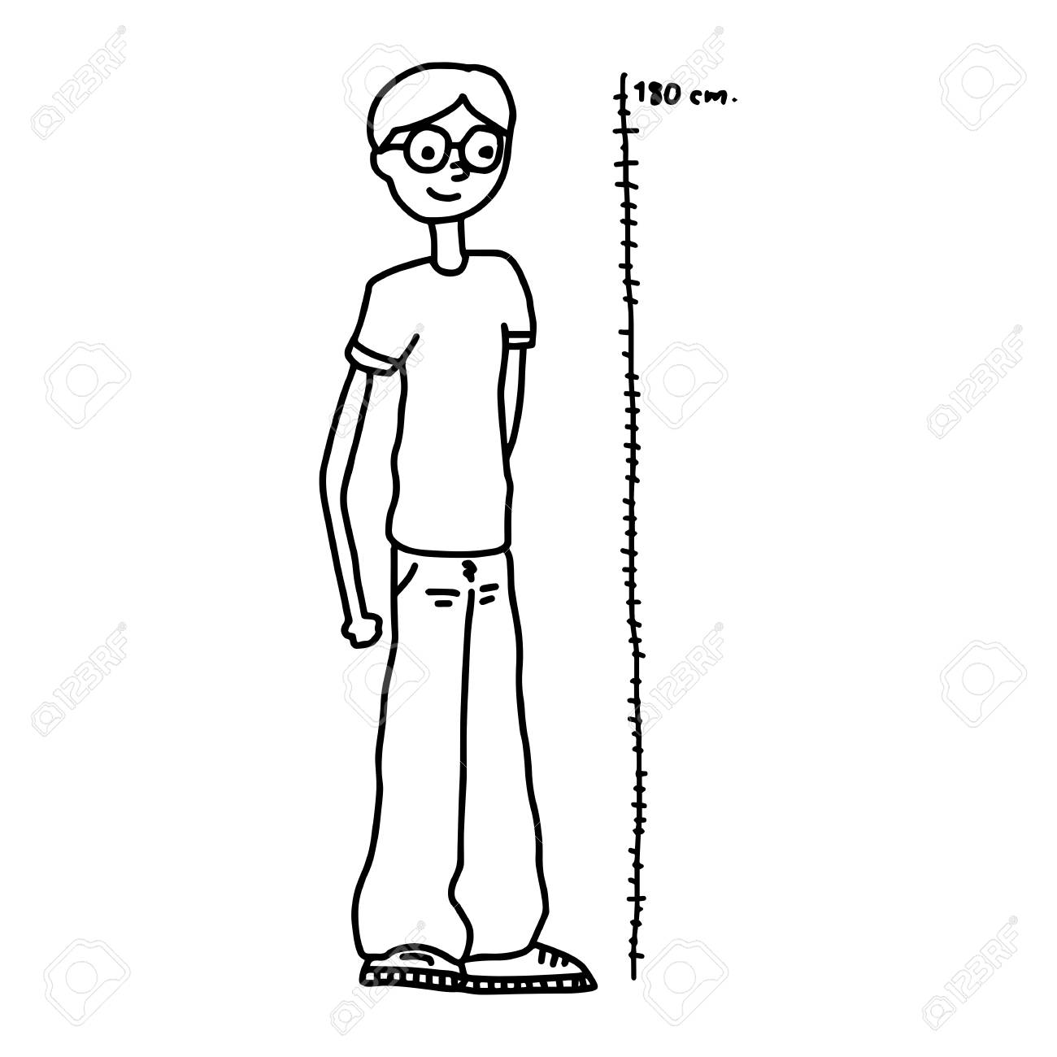
Are you a boy?
Yes, I am.
I am a tall boy.

Slide 17
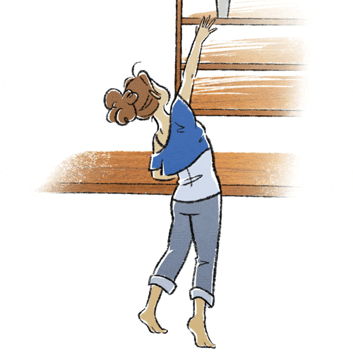
Are you a girl?
Yes, I am.
I am a short girl.

Slide 18
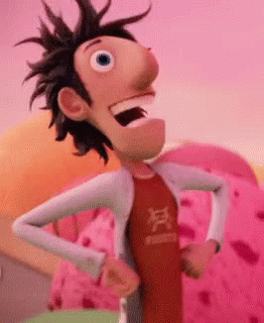
Are you a strong boy?
No, I’m not.
I am a thin boy.

Slide 19
Are you a thin girl?
No, I’m not.
I am a
strong girl.

Slide 20
Attention!!!
I am= I’m.
Yes, I am.中的I am
不可以縮寫。

Slide 21
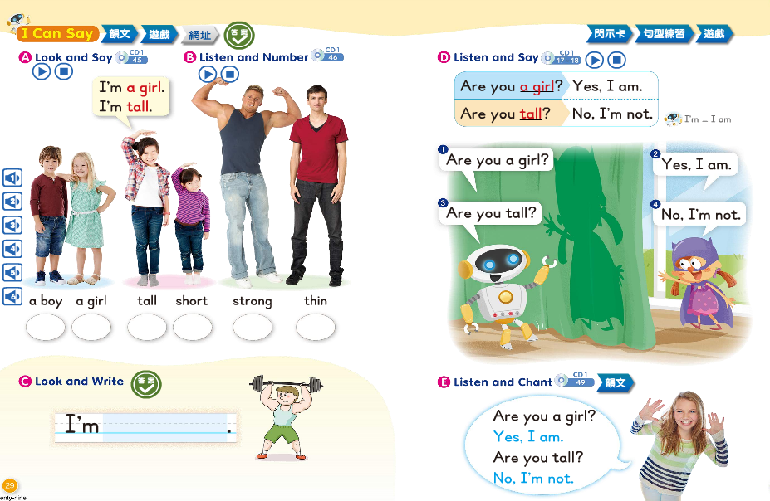

Slide 22
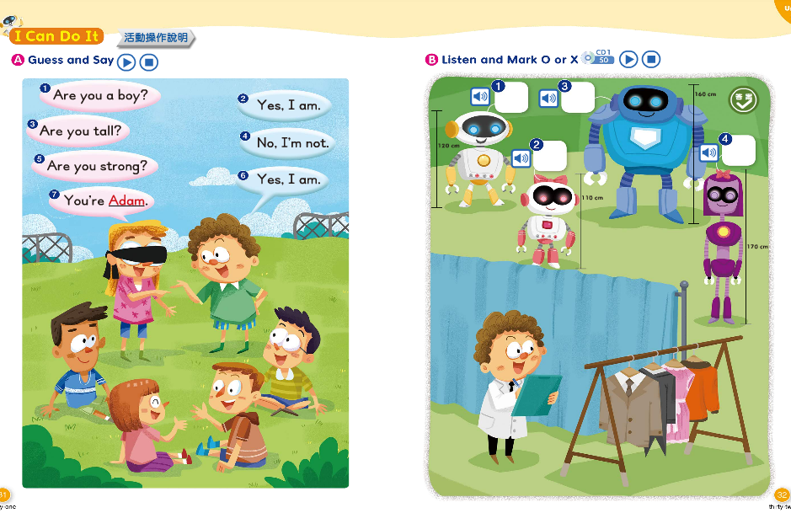

Slide 25
l
t
a
l

Slide 26
b
a
y
o

Slide 27
r
t
g
o
n
s

Slide 28
r
i
a
g
l

Slide 29
n
i
h
t

Slide 30
s
o
t
r
h

Slide 31
you
?
Are
short

Slide 32
am.
,
Yes
I

Slide 33
not.
,
I’m
No

Slide 34
a
boy.
I
thin
am

Slide 35
am
a
I
girl.
strong

